Slide 1

Statistical Studies
Tracey Dudding

Slide 2
The 6 Steps of A Statistical Study
1. Topic of Interest
4. Data Quality
6. Conclusion
2. Research Question
3. Data Collection
5. Analysis

Slide 3


1. Topic of Interest
A general idea of an area you want to study.
Examples:
Genetic Engineering
Climate Change
This Photo by Unknown Author is licensed under CC BY-ND
This Photo by Unknown Author is licensed under CC BY-SA-NC

Slide 4
2. Research Question
Take your general ideas and translate them into research questions that can be answered with data.
What Makes For a Good Research Question??
How Do We Do This??

Slide 5

What Makes for a good research question?
A clear, focused statement with the ability guide and center your entire research.
You Try!
This Photo by Unknown Author is licensed under CC BY-SA-NC
Notes:
Example 1: Why did the chicken cross the road? → This question does not address which chicken or which road; hence it is too broad.
Example 2: How many chickens crossed Broad Street in Durham, NC, on February 6, 2014? → This question does not leave room for analysis.
Example 3: What are some of the environmental factors that occurred in Radford, VA between January and February 2021 that would cause chickens to cross Broad Street? → This question can lead to identifying factors that are significant and identifying to what degree the results are beneficial.

Slide 6

How do we form a good research question?
A Checklist To Help:
Is the question a new spin on an old idea, or does it solve a problem?
Gather facts about it.
Match facts and theory.
Evaluate or compare theories, models, or hypothesis.
Is it to broad or narrow?
Will your results be repeatable and comparable to existing models?

Slide 7
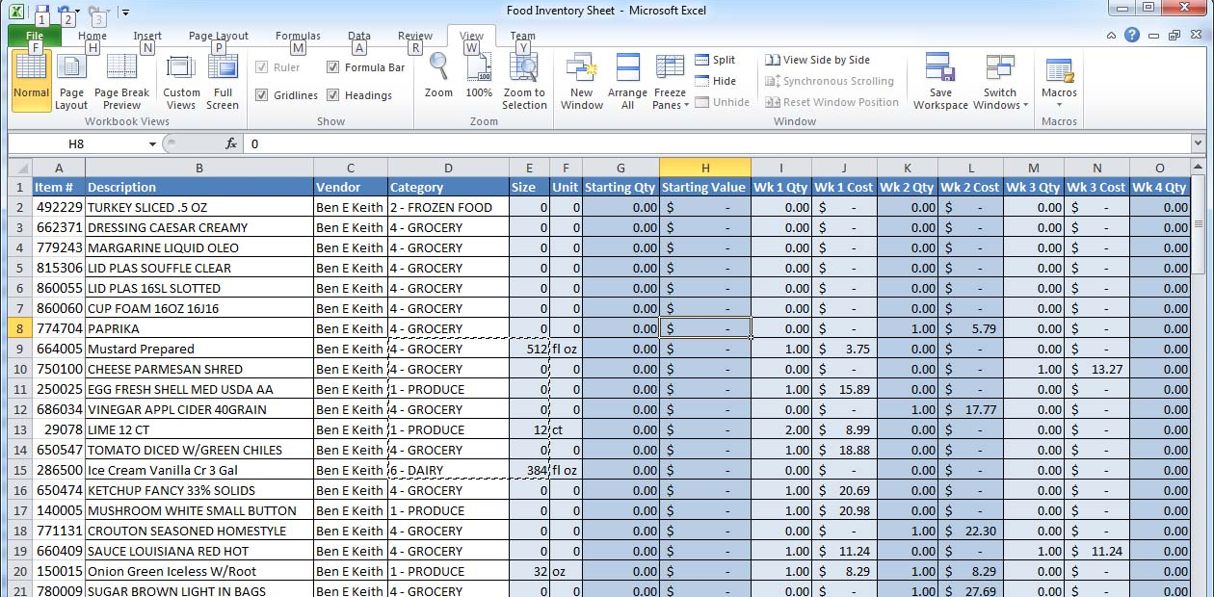

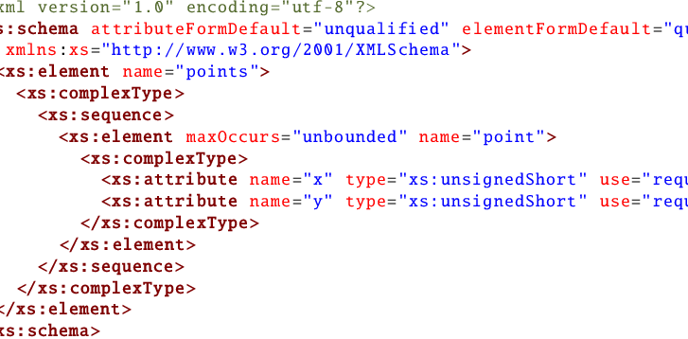
3. Data Collection
You CAN NOT Answer Your Question Without DATA!
Data will likely come from multiple sources…
This Photo by Unknown Author is licensed under CC BY-SA
This Photo by Unknown Author is licensed under CC BY-SA
This Photo by Unknown Author is licensed under CC BY-SA

Slide 8
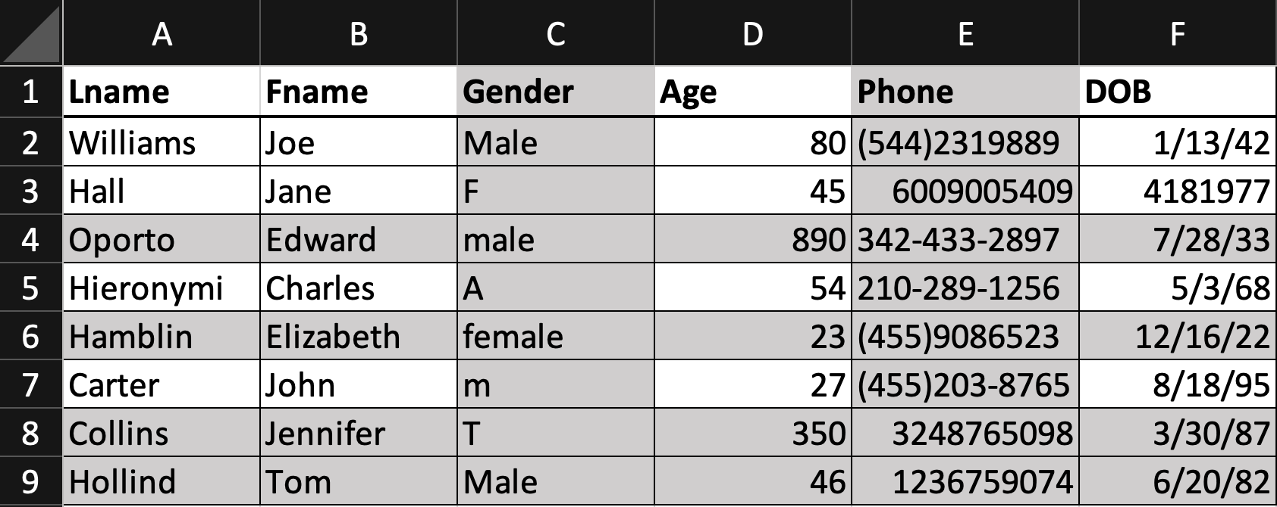
4. Data Quality
Assess if data is in a format to answer your question.
Let’s Look At An Example!
Notes:
Go Through Example on Excel File

Slide 9
5. Analysis
Statistical methods to process the data and generate answers to your questions.
Types of Analysis??
Descriptive Analysis.
Diagnostic Analysis.
Predictive Analysis.
Prescriptive Analysis.
Notes:
We will not go over the types now, but if you want to look into it there will be resources on the last slide.

Slide 10

6. Conclusion
Taking the results of your statistical analysis and presenting it in a form that others can understand.
EXAMPLE!
This Photo by Unknown Author is licensed under CC BY-SA-NC

Slide 11
The 6 Steps of A Statistical Study
1. Topic of Interest
4. Data Quality
6. Conclusion
2. Research Question
3. Data Collection
5. Analysis

Slide 12
Resources & Further topics To explore
Research Questions
Analysis
Descriptive Analysis
Diagnostic Analysis
Predictive Analysis
Prescriptive Analysis
Visual for effectively communicating results
All other content : Exploring the Practices of Statistics (Moor, McCabe, Craig)

